Slide 1

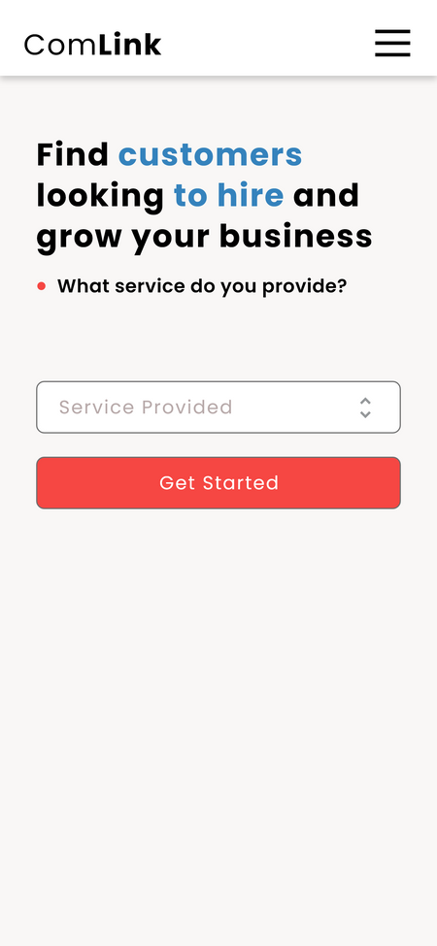
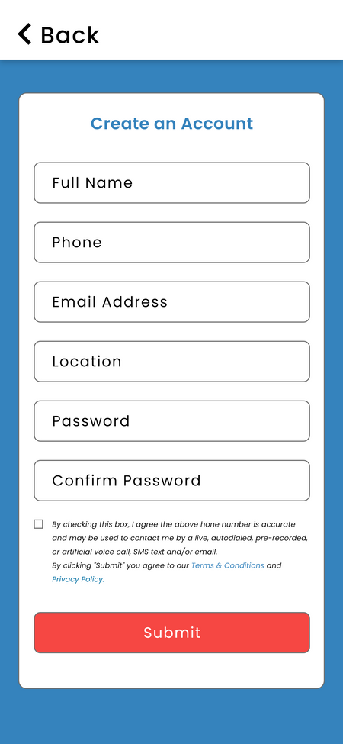
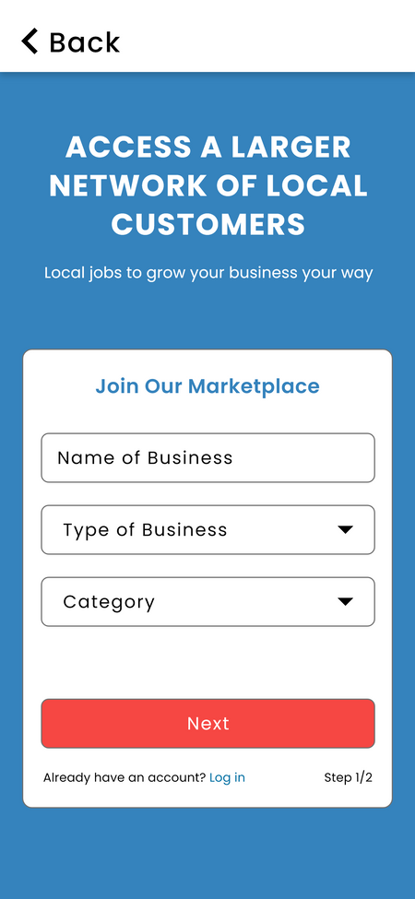
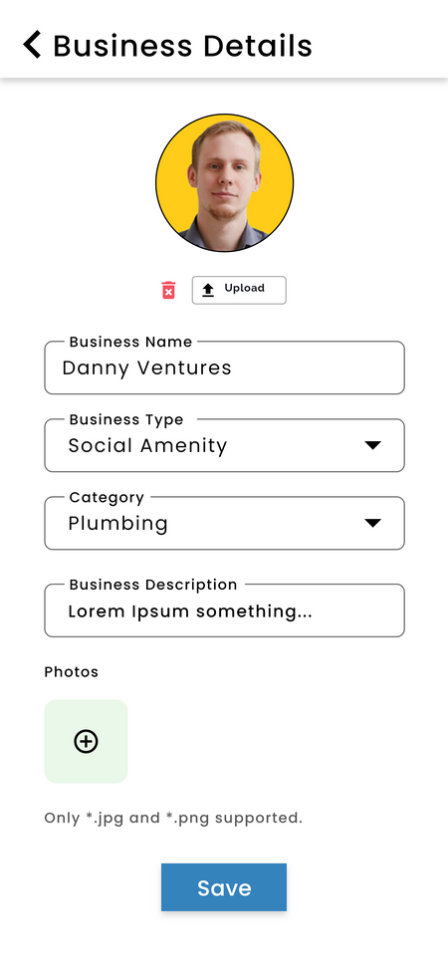
A COMMUNITY-BASED LOCAL SERVICES
AND AMENITIES LOCATOR APP
A project by Daniel Allotey & Mohammed Muniru

Slide 2
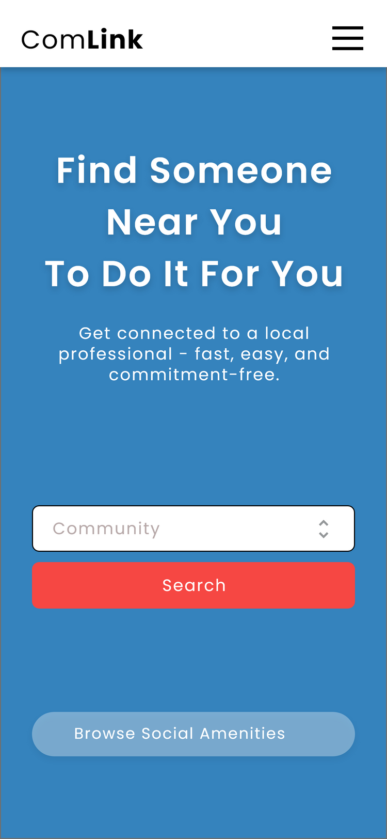
Background of the Study
New residents and visitors struggle to find local services and amenities.
People often ask around or waste time locating basic services like clinics, electricians, or shops.
A location-based mobile solution can help bridge this information gap.
Community Link app was proposed to offer listings of businesses and social amenities within a local area.

Slide 3
Problem Statement
Lack of a centralized platform for discovering community-based services.
Difficulty in locating trusted local businesses and public amenities.
Small business owners struggle with visibility in their own communities.

Slide 4
Objectives
Main Objective:
To develop a mobile application that helps users discover local services and businesses within their community.
Specific Objectives:
Enable users to find and save nearby services (clinics, electricians, shops, etc.).
Allow business owners to register and manage their listings.
Provide an admin dashboard to manage users and content.
Improve community connection through a tech-based solution.

Slide 5
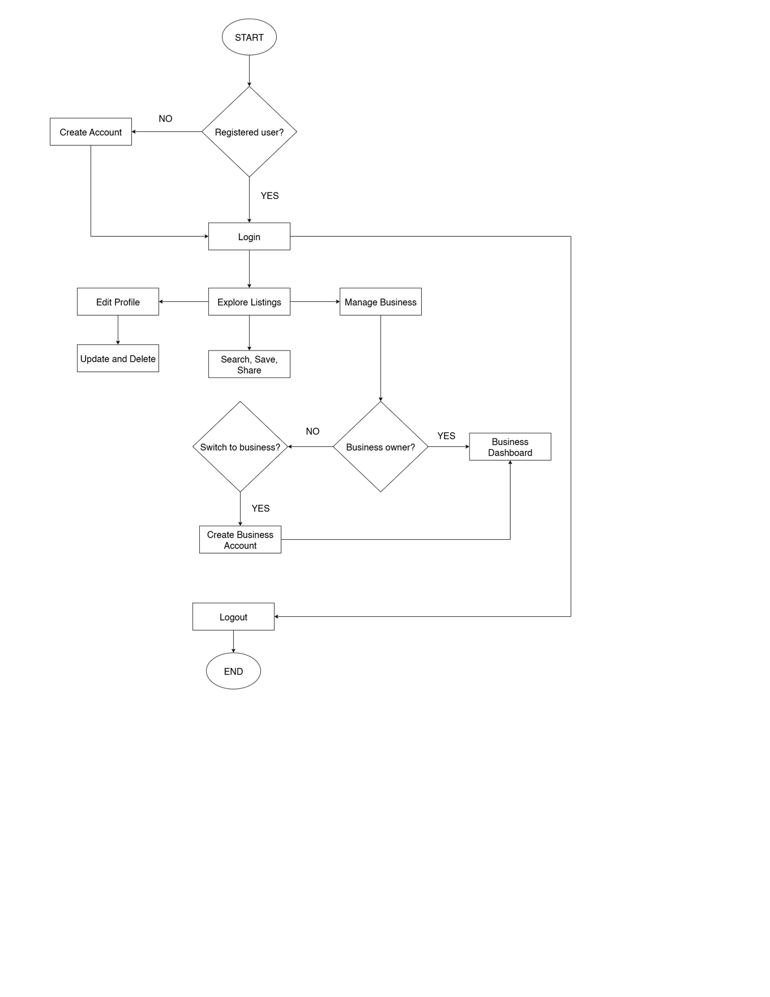
Decision Tree for System Flow

Slide 6
Literature Review
Explored similar platforms like Google Maps and Yelp.
Identified the gap in serving smaller communities and combining social amenities with local business listings.
Built on concepts from location-based services and mobile computing.
Frameworks guided system features like user roles, search filters, and real-time data.

Slide 7
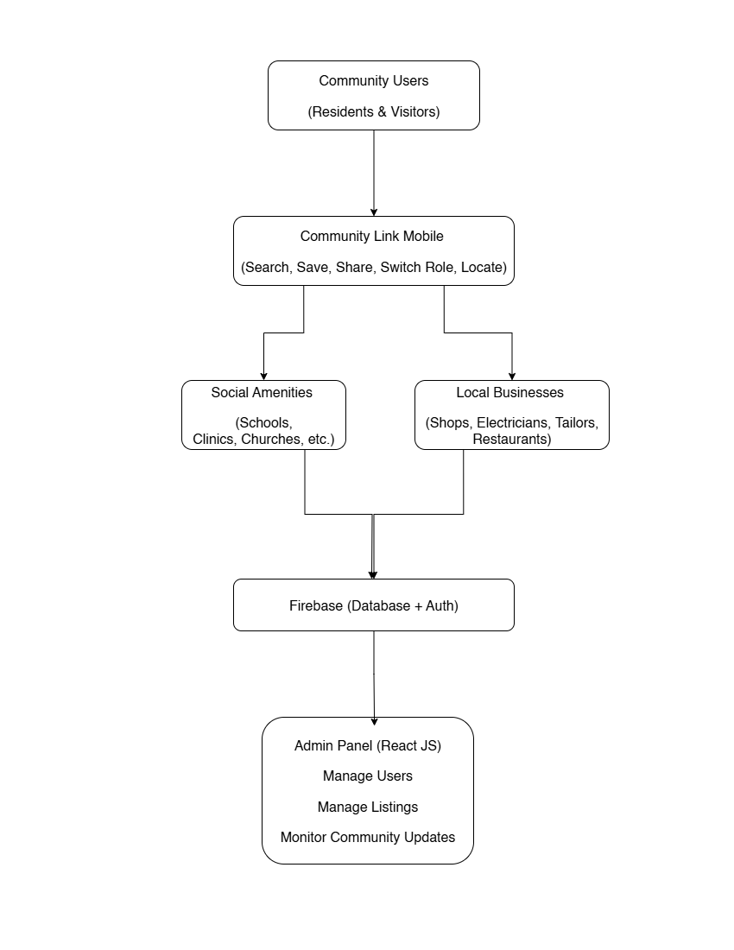
Conceptual Framework Diagram

Slide 8
Methodology
Design: Mobile-based app built with Flutter and Firebase.
Population: Community members – regular users, business users, and one admin.
Sampling: Focused on critical features – login, switching roles, managing listings, admin control.
Instruments: Firebase (backend), Flutter (mobile), React JS (admin panel), GitHub (collaboration).
Development: UI mockups → functional screens → real-time testing and debugging.

Slide 9
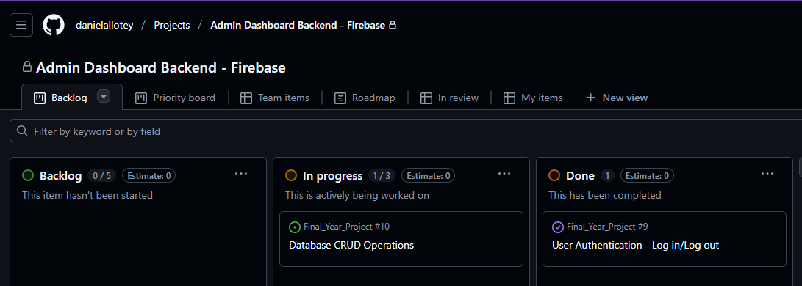
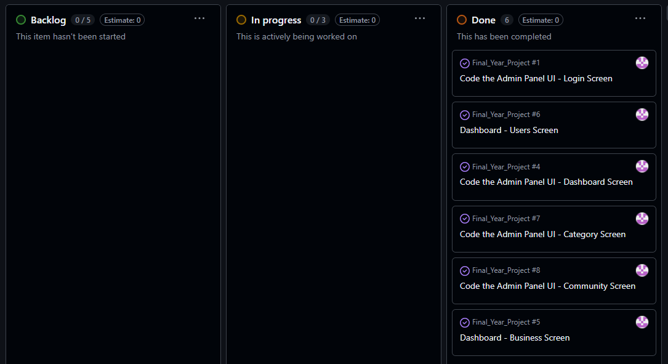
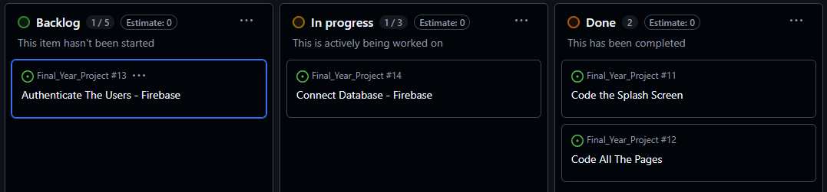
Adopted Agile development using the Kanban model (Github).
Promoted flexibility, continuous delivery, and real-time

Slide 10
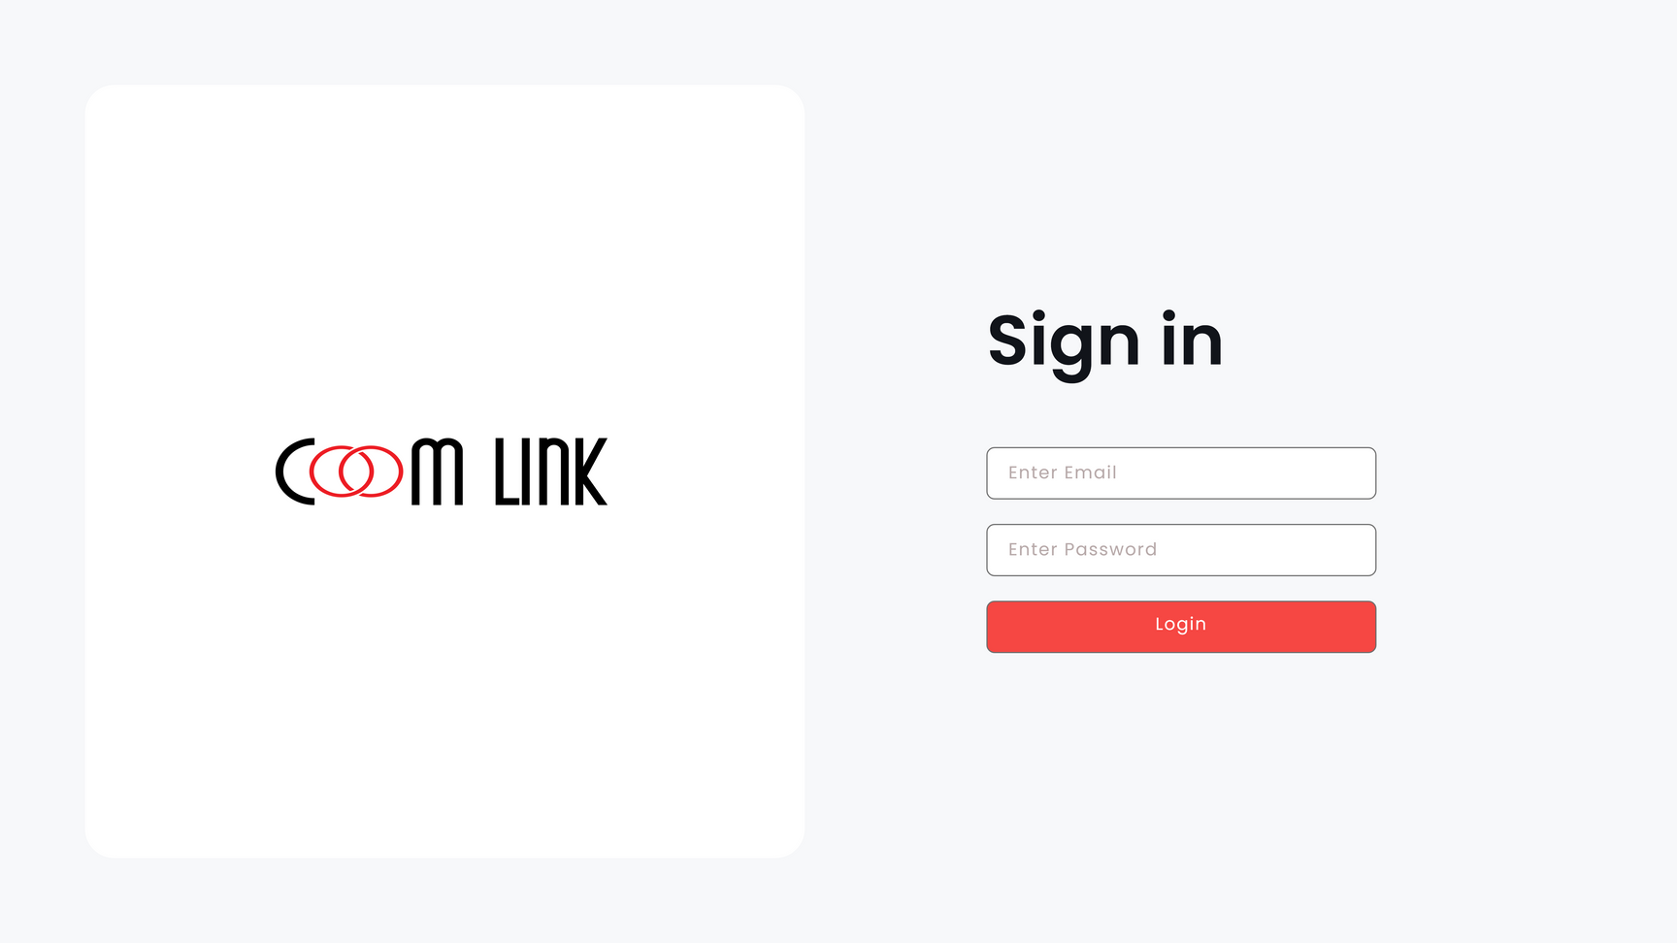
System Design Life Cycle
Planning
Define project scope - Identify stakeholders - Determine resources and timeline
Requirements
Gather functional and non-functional requirements - Define user roles (Admin, Regular User, Business User) - Document system specifications
Design
Plan system architecture - Design database schema (Firebase structure) - Define navigation flow and UX strategy
Development
Implement frontend (Flutter for mobile, React for Admin) - Integrate Firebase services (Auth, Firestore, Storage)
Testing
Conduct integration testing and functional testing - Fix bugs and refine UI/UX - Ensure security and data validation
Deployment
Deploy admin panel online - Used chrome debug mode for mobile app testing (e.g., APK)
Maintenance
Monitor app performance - Apply updates and patches - Collect user feedback and improve features

Slide 11
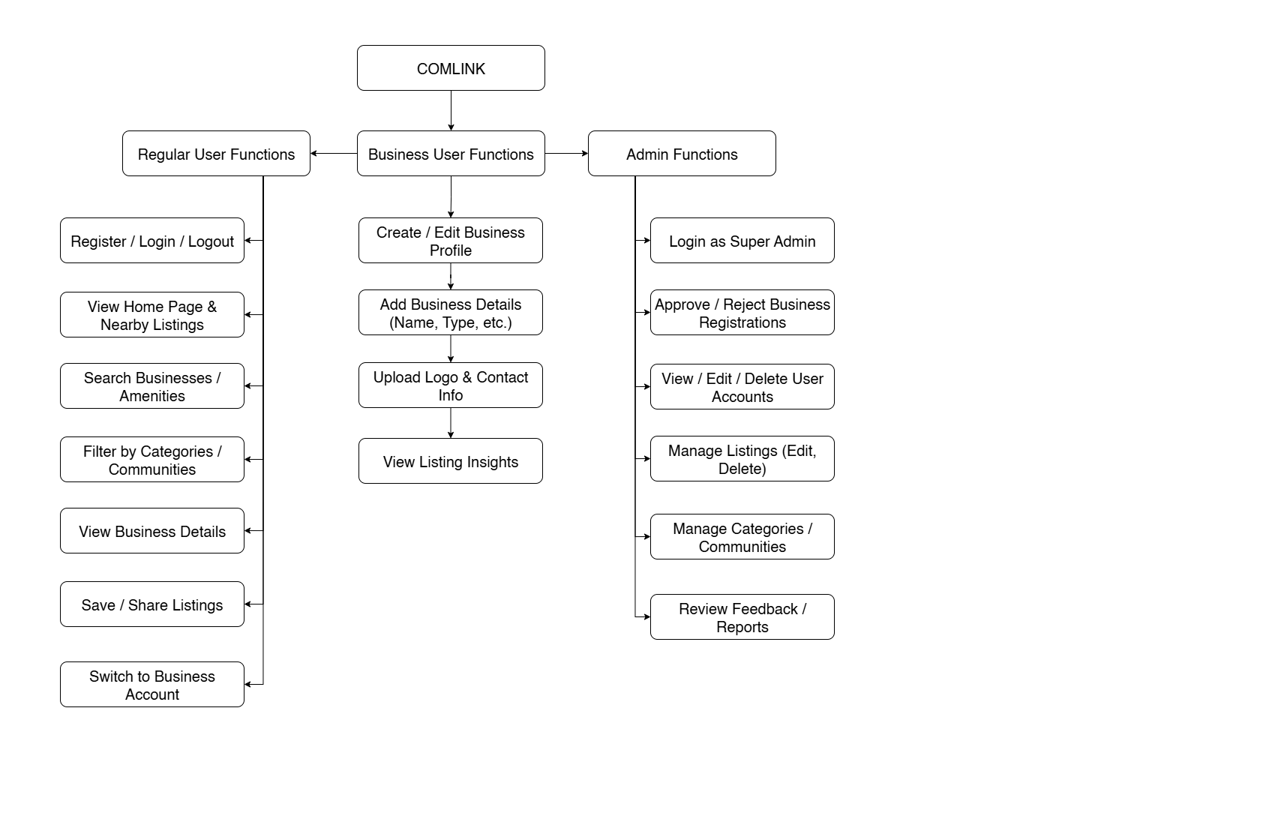
Functional Requirement Diagram

Slide 12
Results and Analysis
Fully working app features:
Sign-up/login
User dashboard with business listings
Account switch (regular to business)
Admin dashboard
Found challenges with syncing, Firebase rules, and UI balance between user roles.

Slide 13
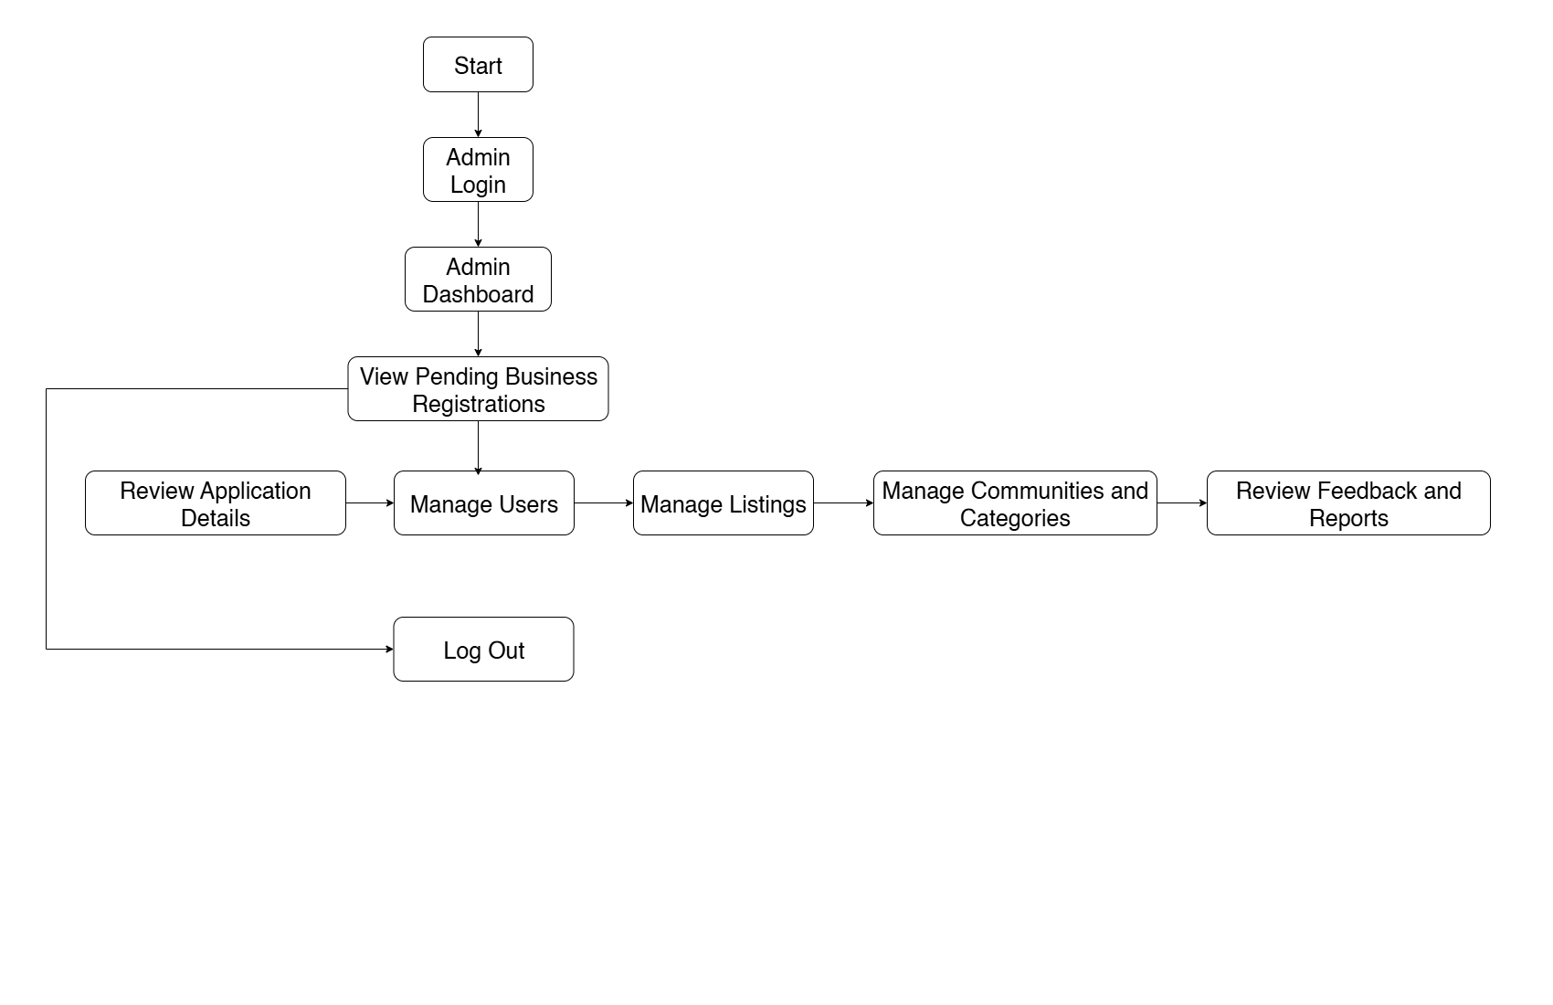
Super Admin Diagram

Slide 14
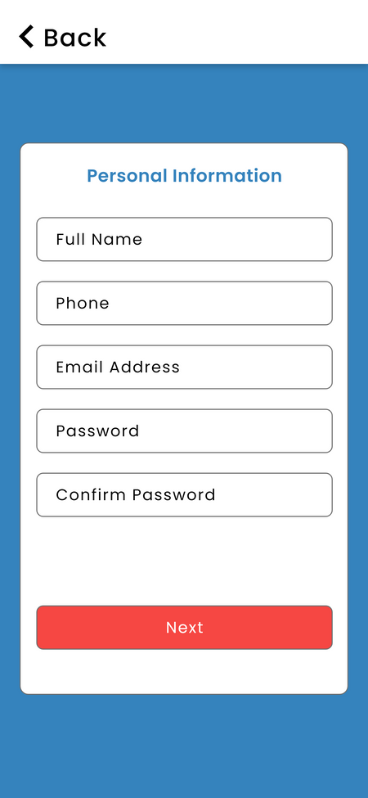
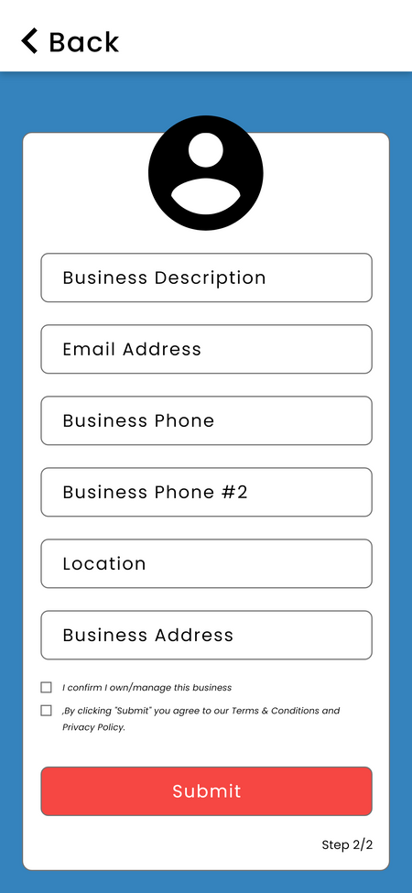
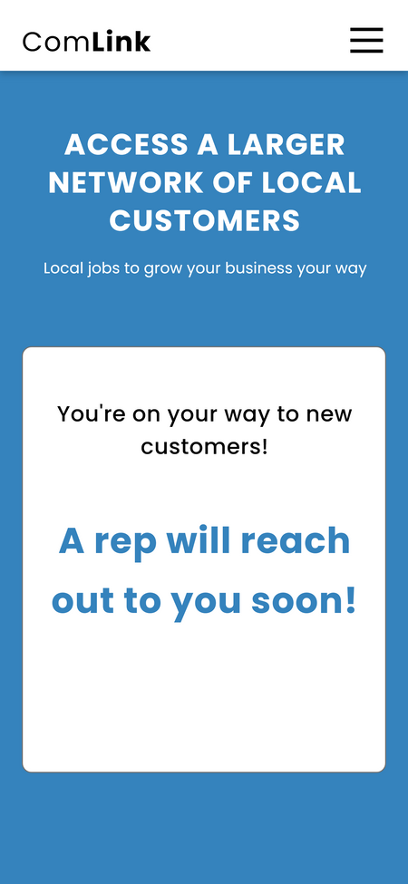
Creating A business Account

Slide 15
Conclusion:
Community Link effectively solves the problem of local discovery.
Brings users and business owners together in a single digital space.

Slide 16
Recommendations:
Add review/rating features in future versions.
Allow multiple admins or community moderators.
Improve offline capabilities for low-data areas.
Add push notifications and business promotions.

Slide 17
References
Tiika, B. J., Tang, Z., Dagadu, J. C., & Azaare, J. (2024). Tourists’ adoption of context-aware applications using locator beacons in Mole National Park, Ghana. SAGE Open, 14(2), 1–18.
Kaonga, N. N., Labrique, A., & Levine, O. (2013). Mobile phones and social structures: An exploration of a closed-user group in rural Ghana. BMC Medical Informatics and Decision Making, 13(100), 1–10.
Courtois, P., & Subervie, J. (2016). An assessment of mobile phone–based dissemination of weather and market information in the Upper West Region of Ghana. Agriculture & Food Security, 5(8), 1–14.

Slide 18



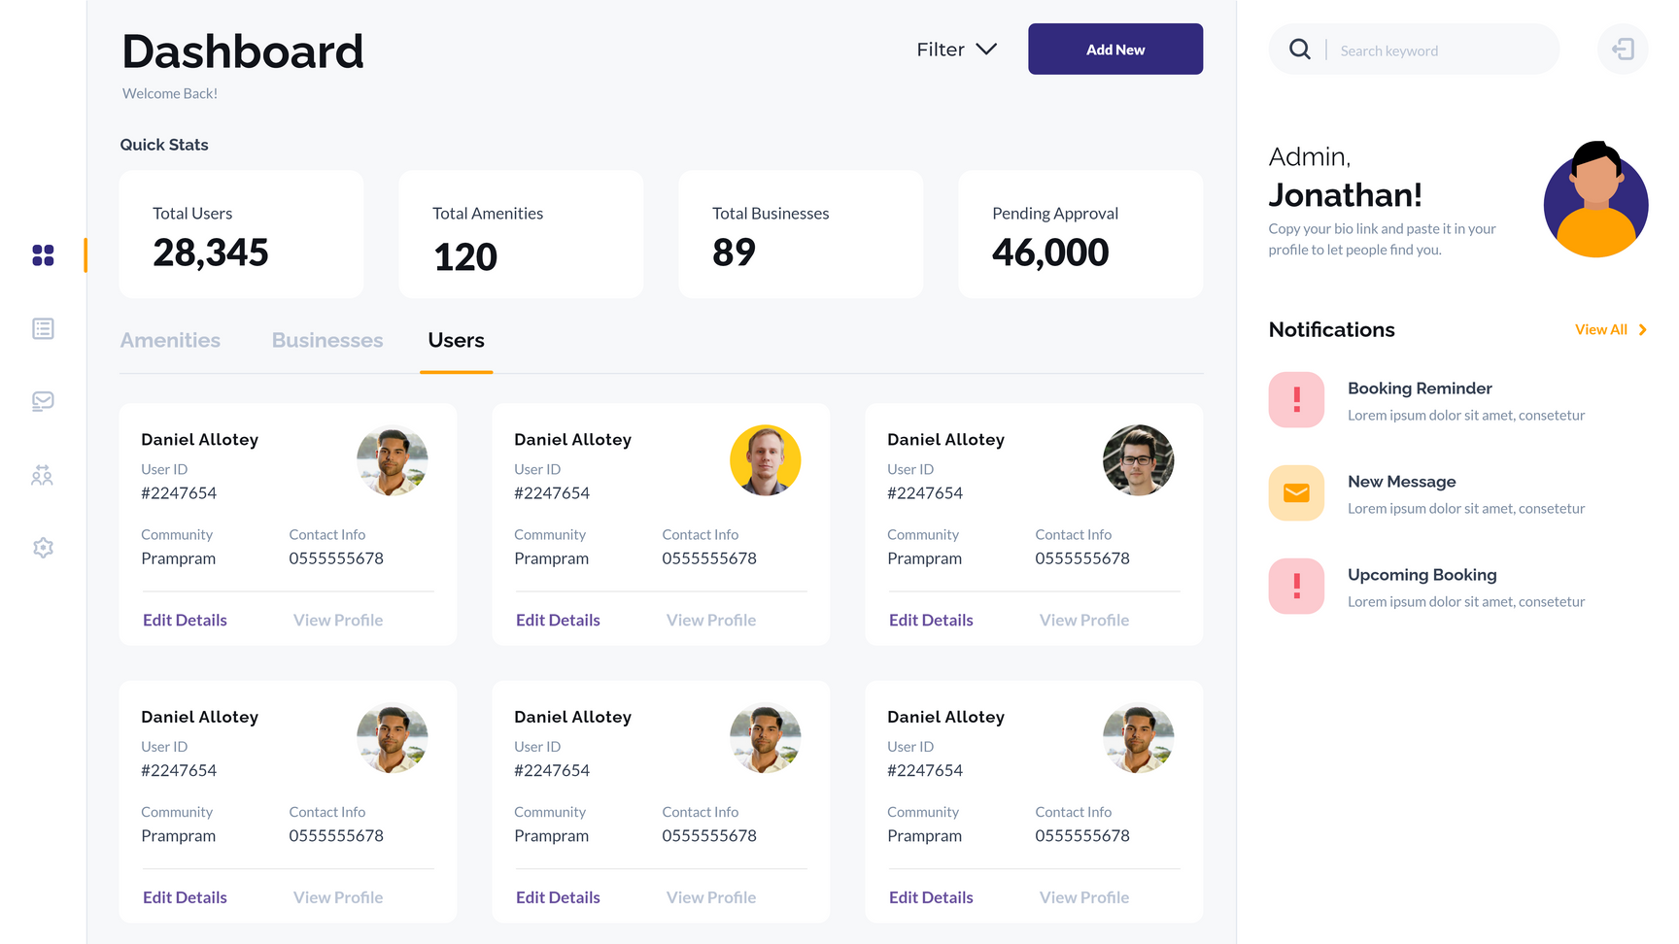
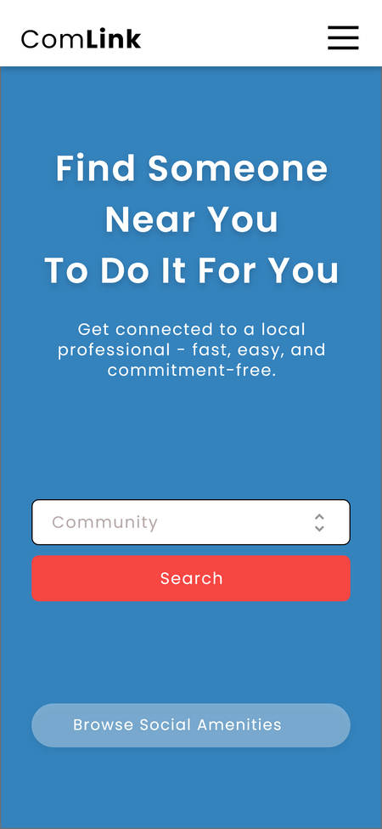
Thank you
Daniel Addotey Allotey - CSC/21/01/1399
Mohammed Muniru - CSC/20/01/2455

